Slide 1

The
PERFORM

Slide 2
The PERFORM Verb
Iteration is an important programming construct. We use iteration when we need to repeat the same instructions over and over again.
Most programming languages have several iteration keywords (e.g. WHILE, FOR, REPEAT) which facilitate the creation different ‘types’ of iteration structure.
COBOL only has one iteration construct; PERFORM.
But the PERFORM has several variations.
Each variation is equivalent to one of the iteration ‘types’ available in other languages.

Slide 3
Run of PerformFormat1
In TopLevel. Starting to run program
>>>> Now in OneLevelDown
>>>>>>>> Now in TwoLevelsDown.
>>>> Back in OneLevelDown
Back in TopLevel.
PROCEDURE DIVISION.
TopLevel.
DISPLAY "In TopLevel. Starting to run program"
PERFORM OneLevelDown
DISPLAY "Back in TopLevel.".
STOP RUN.
TwoLevelsDown.
DISPLAY ">>>>>>>> Now in TwoLevelsDown."
OneLevelDown.
DISPLAY ">>>> Now in OneLevelDown"
PERFORM TwoLevelsDown
DISPLAY ">>>> Back in OneLevelDown".

Slide 4
Run of PerformFormat1
In TopLevel. Starting to run program
>>>> Now in OneLevelDown
>>>>>>>> Now in TwoLevelsDown.
>>>> Back in OneLevelDown
Back in TopLevel.
PROCEDURE DIVISION.
TopLevel.
DISPLAY "In TopLevel. Starting to run program"
PERFORM OneLevelDown
DISPLAY "Back in TopLevel.".
STOP RUN.
TwoLevelsDown.
DISPLAY ">>>>>>>> Now in TwoLevelsDown."
OneLevelDown.
DISPLAY ">>>> Now in OneLevelDown"
PERFORM TwoLevelsDown
DISPLAY ">>>> Back in OneLevelDown".

Slide 5
Run of PerformFormat1
In TopLevel. Starting to run program
>>>> Now in OneLevelDown
>>>>>>>> Now in TwoLevelsDown.
>>>> Back in OneLevelDown
Back in TopLevel.
PROCEDURE DIVISION.
TopLevel.
DISPLAY "In TopLevel. Starting to run program"
PERFORM OneLevelDown
DISPLAY "Back in TopLevel.".
STOP RUN.
TwoLevelsDown.
DISPLAY ">>>>>>>> Now in TwoLevelsDown."
OneLevelDown.
DISPLAY ">>>> Now in OneLevelDown"
PERFORM TwoLevelsDown
DISPLAY ">>>> Back in OneLevelDown".

Slide 6
Run of PerformFormat1
In TopLevel. Starting to run program
>>>> Now in OneLevelDown
>>>>>>>> Now in TwoLevelsDown.
>>>> Back in OneLevelDown
Back in TopLevel.
PROCEDURE DIVISION.
TopLevel.
DISPLAY "In TopLevel. Starting to run program"
PERFORM OneLevelDown
DISPLAY "Back in TopLevel.".
STOP RUN.
TwoLevelsDown.
DISPLAY ">>>>>>>> Now in TwoLevelsDown."
OneLevelDown.
DISPLAY ">>>> Now in OneLevelDown"
PERFORM TwoLevelsDown
DISPLAY ">>>> Back in OneLevelDown".

Slide 7
Run of PerformFormat1
In TopLevel. Starting to run program
>>>> Now in OneLevelDown
>>>>>>>> Now in TwoLevelsDown.
>>>> Back in OneLevelDown
Back in TopLevel.
PROCEDURE DIVISION.
TopLevel.
DISPLAY "In TopLevel. Starting to run program"
PERFORM OneLevelDown
DISPLAY "Back in TopLevel.".
STOP RUN.
TwoLevelsDown.
DISPLAY ">>>>>>>> Now in TwoLevelsDown."
OneLevelDown.
DISPLAY ">>>> Now in OneLevelDown"
PERFORM TwoLevelsDown
DISPLAY ">>>> Back in OneLevelDown".

Slide 8
Run of PerformFormat1
In TopLevel. Starting to run program
>>>> Now in OneLevelDown
>>>>>>>> Now in TwoLevelsDown.
>>>> Back in OneLevelDown
Back in TopLevel.
PROCEDURE DIVISION.
TopLevel.
DISPLAY "In TopLevel. Starting to run program"
PERFORM OneLevelDown
DISPLAY "Back in TopLevel.".
STOP RUN.
TwoLevelsDown.
DISPLAY ">>>>>>>> Now in TwoLevelsDown."
OneLevelDown.
DISPLAY ">>>> Now in OneLevelDown"
PERFORM TwoLevelsDown
DISPLAY ">>>> Back in OneLevelDown".

Slide 9
Run of PerformFormat1
In TopLevel. Starting to run program
>>>> Now in OneLevelDown
>>>>>>>> Now in TwoLevelsDown.
>>>> Back in OneLevelDown
Back in TopLevel.
PROCEDURE DIVISION.
TopLevel.
DISPLAY "In TopLevel. Starting to run program"
PERFORM OneLevelDown
DISPLAY "Back in TopLevel.".
STOP RUN.
TwoLevelsDown.
DISPLAY ">>>>>>>> Now in TwoLevelsDown."
OneLevelDown.
DISPLAY ">>>> Now in OneLevelDown"
PERFORM TwoLevelsDown
DISPLAY ">>>> Back in OneLevelDown".

Slide 10
Run of PerformFormat1
In TopLevel. Starting to run program
>>>> Now in OneLevelDown
>>>>>>>> Now in TwoLevelsDown.
>>>> Back in OneLevelDown
Back in TopLevel.
PROCEDURE DIVISION.
TopLevel.
DISPLAY "In TopLevel. Starting to run program"
PERFORM OneLevelDown
DISPLAY "Back in TopLevel.".
STOP RUN.
TwoLevelsDown.
DISPLAY ">>>>>>>> Now in TwoLevelsDown."
OneLevelDown.
DISPLAY ">>>> Now in OneLevelDown"
PERFORM TwoLevelsDown
DISPLAY ">>>> Back in OneLevelDown".

Slide 11
Go To Statement
The GO TO statement transfers control from one part of the Procedure Division to another. The types of GO TO statements are:
    Unconditional
    Conditional
GO TO SumSalesExit.
GO TO CASE-ONE DEPENDING ON ACCOUNT-TYPE.
EXIT Statement
The EXIT verb indicates a no operation, and when executed, no action takes place.
SumSalesExit.
EXIT.

Slide 12

Perform with Thru option
This is the only type of PERFORM that is not an iteration construct.
It instructs the computer to transfer control to an out-of-line block of code.
When the end of the block is reached, control reverts to the statement (not the sentence) immediately following the PERFORM.
1stProc and EndProc are the names of Paragraphs or Sections.
The PERFORM..THRU instructs the computer to treat the Paragraphs or Sections from 1stProc TO EndProc as a single block of code.

Slide 13
Go To and Perform with Thru option
PROCEDURE DIVISION
Begin.
PERFORM SumSales THRU SumSalesExit
STOP RUN.
SumSales.
Statements
Statements
IF ErrorFound GO TO SumSalesExit
END-IF
Statements
Statements
Statements
IF ErrorFound GO TO SumSalesExit
END-IF
Statements
SumSalesExit.
EXIT.

Slide 14
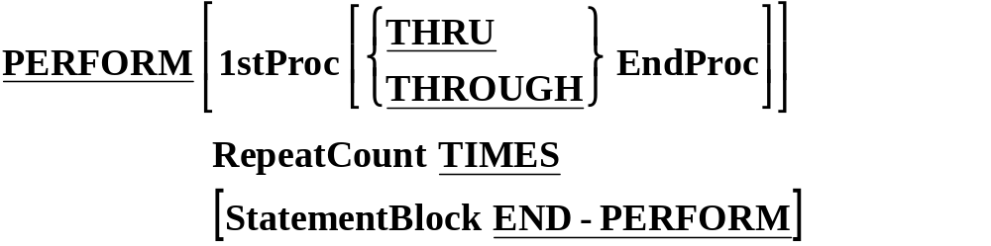
Perform with Times option
PROCEDURE DIVISION.
Begin.
DisplayName.
Statements
PERFORM DisplayName 4 TIMES
Statements
STOP RUN.
DISPLAY “ Sudharshana ”.

Slide 15
In Line Perform option
Run of PerformExample2
$ SET SOURCEFORMAT"FREE"
IDENTIFICATION DIVISION.
PROGRAM-ID. PerformExample2.
AUTHOR. Michael Coughlan.
DATA DIVISION.
WORKING-STORAGE SECTION.
01 NumofTimes PIC 9 VALUE 5.
PROCEDURE DIVISION.
Begin.
DISPLAY "Starting to run program"
PERFORM 3 TIMES
DISPLAY ">>>>This is an in line Perform"
END-PERFORM
DISPLAY "Finished in line Perform"
PERFORM OutOfLineEG NumOfTimes TIMES
DISPLAY "Back in Begin. About to Stop".
STOP RUN.
OutOfLineEG.
DISPLAY ">>>> This is an out of line Perform".
Starting to run program
>>>>This is an in line Perform
>>>>This is an in line Perform
>>>>This is an in line Perform
Finished in line Perform
>>>> This is an out of line Perform
>>>> This is an out of line Perform
>>>> This is an out of line Perform
>>>> This is an out of line Perform
>>>> This is an out of line Perform
Back in Begin. About to Stop

Slide 16
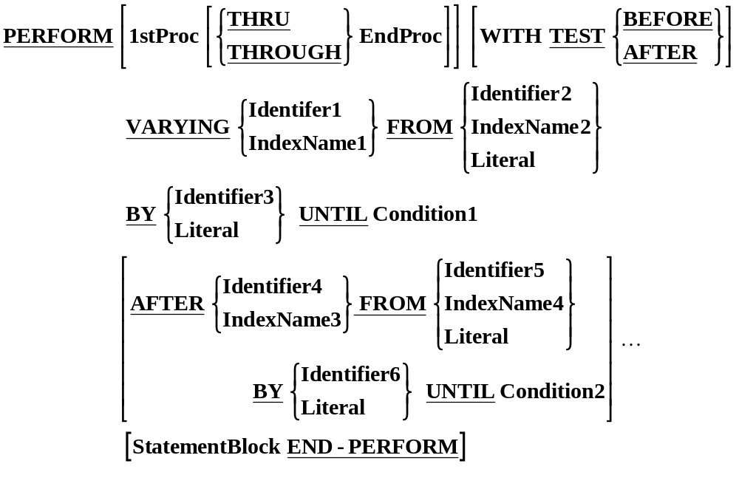
PERFORM..VARYING Syntax

Slide 17
Perform with Until option
MOVE ZERO TO SUM, NUMB.
PERFORM ADD-PARA UNTIL NUMB = 50.
ADD-PARA.
ADD 1 TO NUMB, ADD NUMB TO SUM.
Perform with Varying option
MOVE ZERO TO SUM, NUMB.
PERFORM ADD-PARA VARYING NUMB
FROM 1 BY 1 UNTIL NUMB > 10.
ADD-PARA.
ADD NUMB TO SUM.
Perform with Varying- After option
PERFORM RANGE-TO-BE-EXECUTED
VARYING I FROM 1 BY 1 UNTIL I > 20
AFTER J FROM 1 BY 1 UNTIL J > 10.

Slide 18
PERFORM VARYING Idx1 FROM 1 BY 1 UNTIL
Idx1 EQUAL TO 3
DISPLAY Idx1
END-PERFORM.
Idx1
1
Move 1 to Idx1
Idx1 = 3
True
Next Statement
False
Loop Body
Inc Idx1

Slide 19
PERFORM VARYING Idx1 FROM 1 BY 1 UNTIL
Idx1 EQUAL TO 3
DISPLAY Idx1
END-PERFORM.
Idx1
1
Move 1 to Idx1
Idx1 = 3
True
Next Statement
False
Loop Body
Inc Idx1

Slide 20
PERFORM VARYING Idx1 FROM 1 BY 1 UNTIL
Idx1 EQUAL TO 3
DISPLAY Idx1
END-PERFORM.
Idx1
1
Move 1 to Idx1
Idx1 = 3
True
Next Statement
False
1
Loop Body
Inc Idx1

Slide 21
PERFORM VARYING Idx1 FROM 1 BY 1 UNTIL
Idx1 EQUAL TO 3
DISPLAY Idx1
END-PERFORM.
Idx1
2
Move 1 to Idx1
Idx1 = 3
True
Next Statement
False
1
Loop Body
Inc Idx1

Slide 22
PERFORM VARYING Idx1 FROM 1 BY 1 UNTIL
Idx1 EQUAL TO 3
DISPLAY Idx1
END-PERFORM.
Idx1
2
Move 1 to Idx1
Idx1 = 3
True
Next Statement
False
1
Loop Body
Inc Idx1

Slide 23
PERFORM VARYING Idx1 FROM 1 BY 1 UNTIL
Idx1 EQUAL TO 3
DISPLAY Idx1
END-PERFORM.
Idx1
2
Move 1 to Idx1
Idx1 = 3
True
Next Statement
False
1
2
Loop Body
Inc Idx1

Slide 24
PERFORM VARYING Idx1 FROM 1 BY 1 UNTIL
Idx1 EQUAL TO 3
DISPLAY Idx1
END-PERFORM.
Idx1
3
Move 1 to Idx1
Idx1 = 3
True
Next Statement
False
1
2
Loop Body
Inc Idx1

Slide 25
PERFORM VARYING Idx1 FROM 1 BY 1 UNTIL
Idx1 EQUAL TO 3
DISPLAY Idx1
END-PERFORM.
Idx1
3
Move 1 to Idx1
Idx1 = 3
True
Next Statement
Exit value = 3
Next Statement
False
1
2
Loop Body
Inc Idx1

Slide 26
PERFORM IterationCount VARYING Idx1 FROM 1 BY 2
UNTIL Idx1 EQUAL TO 5
AFTER Idx2 FROM 6 BY -1
UNTIL Idx2 LESS THAN 4
Move 1 to Idx1
Move 6 to Idx2
T Idx1 Idx2
1 1 6
2 1 5
3 1 4
4 3 6
5 3 5
6 3 4
x = 5 = 6
Idx1 = 5
Y
Next Statement
N
Idx2 < 4
Y
N
IterationCount
Move 6 to Idx2
Inc Idx1
Dec Idx2

